Slide 1
Part 6: Memory Organization
Bind Code and Data to Memory
  address binding, logical versus physical address space
Contiguous Allocation
  fixed vs. dynamic partitioning, fragmentation
Paging
  address translation, page table implementation, shared pages, two-level page-table, inverted page table
Segmentation
  address translation
CE2005/CZ2005 Operating Systems
Notes:
Effective memory management is vital in a multiprogramming system. If only a few processes are in memory, then for much of the time all of the processes will be waiting for I/O and CPU will be idle. Thus memory needs to be allocated to ensure a reasonable supply of ready processes to consume available CPU time.
We begin this chapter by understanding how a process gets executed. Next, we approach the technology of memory management by looking at a variety of schemes that have been used.

Slide 2
Bind Code and Data to Memory
To run a program, a process image must be created and loaded into memory
text
(code section, program)
data
(global parameters)
heap
(dynamically allocated variables,
e.g., a=new int[10])
stack
(parameters and local variables
in a function)
CE2005/CZ2005 Operating Systems
Notes:
How is memory allocated for a process image?
Logical view of a process image in memory – not just code and data, but also include dynamic memory space (stack and heap) required during process execution

Slide 3
Binding of Code and Data to Memory (Cont.)
Source
code
Compiler: Translate source code to object code
Linker: Combine object modules to resolve references
Loader: - Create process image
- Allocate memory
- Load process image to the allocated memory
Compiler
Library
code
Loader
Process
Image
Object
Module
Linker
Load
Module
Disk
Memory
CE2005/CZ2005 Operating Systems
Notes:
How is a process image generated and loaded?
Loader is part of OS

Slide 4
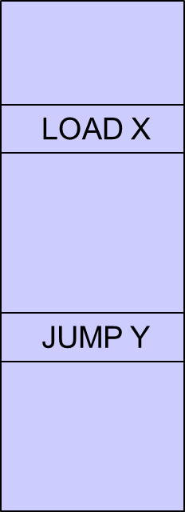
Binding of Code and Data to Memory (Cont.)
.
.
Instruction needs to be fetched from memory
LOAD X
.
.
CPU
Execute an instruction may again require to access memory
Can address X be used to load data?
.
.
Memory
CE2005/CZ2005 Operating Systems
Notes:
Instruction execution cycle
Address generated while executing an instruction may not be used directly to access physical memory
CPU must deal with memory references within the program. Branch instructions contain an address to reference the instruction to be executed next. Data reference instructions contain the address of the byte or word of data referenced.

Slide 5
Binding of Code and Data to Memory (Cont.)
Address binding of instructions and data to memory addresses can happen at three different stages.
Compile time: If memory location known a priori, absolute code can be generated; must recompile code if starting location changes.
Load time: Compiler generates relocatable code. Binding is performed by the loader.
Execution time: If the process can be moved during its execution from one memory segment to another, binding is delayed until run time.
CE2005/CZ2005 Operating Systems

Slide 6
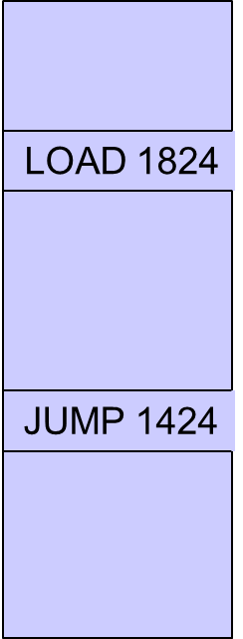
Binding of Code and Data to Memory (Cont.)
In compile- or load-time binding, absolute address format is used in process image
base
1024
.
.
fetch an instruction
LOAD 1824
1424
.
.
load
data
CPU
.
.
If address generated by CPU < base OR ≥ base + limit ⇒ error
Otherwise, memory address = address generated by CPU
1824
.
.
base+limit
2024
Memory
CE2005/CZ2005 Operating Systems
Notes:
Absolute address is used directly to access memory
Static, once process image is loaded, it can’t be moved in the memory
Not interested in compile- or load-time binding

Slide 7
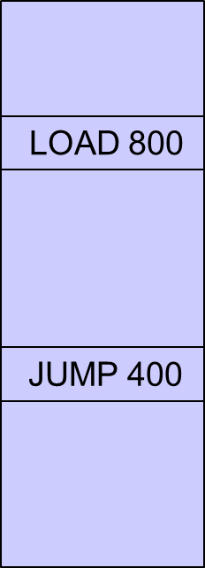
Binding of Code and Data to Memory (Cont.)
In execution-time binding, relative address format is used in process image
base
1024
.
.
fetch an instruction
LOAD 800
1424
.
.
load
data
CPU
.
.
If address generated by CPU ≥ limit ⇒ error
Otherwise, memory address = address generated by CPU + base
1824
.
.
base+limit
2024
Memory
CE2005/CZ2005 Operating Systems
Notes:
Relative address – relative to the beginning of the process image
Base – starting address where process image is loaded in the memory
Address generated by CPU needs to be translated to the one used to access memory
This translation depends on memory allocation method used
Hardware support for translation – base and limit registers
Dynamic, process image can be moved in the memory
Assume execution-time binding
In a multiprogramming system, the available memory is generally shared among a number of processes. Typically, it is not possible for the programmer to know in advance which other programs will be resident in main memory at the time of execution of his or her program. In addition, we would like to be able to:
Perform memory compaction
Swap in and out process
Provide virtual memory support

Slide 8
Logical vs. Physical Address Space
Logical address – generated by the CPU; also referred to as virtual address.
Physical address – address seen by the memory unit.
Address Space – address accessible by the process
Both physical and logical address spaces can be viewed as a linear, or one-dimensional, address space consisting of a sequence of bytes
0
1
.
.
.
Process Image /
Logical Address Space /
Logical Memory
Limit
i
.
.
.
Limit-1
CE2005/CZ2005 Operating Systems
Notes:
Process executes in logical address space and it never sees physical address
To access physical memory, logical address needs to be translated into physical address

Slide 9
How to Allocate Memory among Processes
Two approaches:
  Contiguous Allocation
  The logical address space of a process remains contiguous in physical memory
    Fixed Partitioning
    Dynamic Partitioning
  Non-contiguous Allocation
  A process logical address space is scattered over different regions in physical memory
CE2005/CZ2005 Operating Systems

Slide 10
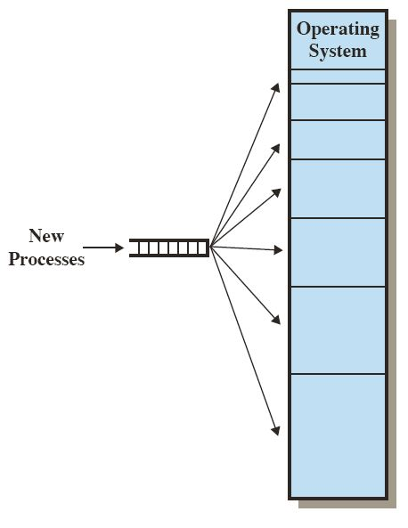
Contiguous Allocation
Fixed Partitioning
Memory is partitioned into regions with fixed boundaries
CE2005/CZ2005 Operating Systems
Notes:
• The number of partitions specified at system generation time limits the number of active processes in the system.
• Because partition sizes are preset at system generation time, small processes will not utilize partition space efficiently. Any process, no matter how small, occupies an entire partition. In an environment where the main storage requirement of all processes is known beforehand, this may be reasonable, but in most cases, it is an inefficient technique.

Slide 11
Contiguous Allocation (Cont.)
Dynamic Partitioning
  Hole – block of available memory; holes of various size are scattered throughout memory.
  When a process arrives, it is allocated memory from a hole large enough to accommodate it.
  Operating system maintains information about
    allocated partitions
    free partitions (hole)
CE2005/CZ2005 Operating Systems
Notes:
Initially, a single hole
Memory allocation status may change while processes are created (allocate memory) and terminate (de-allocate memory)
Eventually, as time goes, memory contains a list of holes of vary size

Slide 12
Contiguous Allocation (Cont.)
0
Operating
system
Job queue
400K
process
memory
time
P1
P2
P3
P4
P5
600K
1000K
300K
700K
500K
10
5
20
8
15
2160K
2560K
CE2005/CZ2005 Operating Systems

Slide 13
Contiguous Allocation (Cont.)
0
Operating
system
Operating
system
Operating
system
Operating
system
Operating
system
400K
P1
P1
P1
P1
P5
1000K
P4
P4
P4
P2
2000K
P3
P3
P3
P3
P3
2300K
2560K
CE2005/CZ2005 Operating Systems
Notes:
With dynamic partitioning, the partitions are of variable length and number. When a process is brought into main memory, it is allocated exactly as much memory as it requires and no more.

Slide 14
Dynamic Storage-Allocation Problem
How to satisfy a request of size n from a list of free holes.
First-fit: Allocate the first hole that is big enough.
Best-fit: Allocate the smallest hole that is big enough; must search entire list, unless ordered by size. Produces the smallest leftover hole.
Worst-fit: Allocate the largest hole; must also search entire list. Produces the largest leftover hole.
CE2005/CZ2005 Operating Systems
Notes:
Given memory requirement of a process, determine which one to use amongst a list of free holes

Slide 15
Fragmentation
External fragmentation: when enough total memory space exists to satisfy a request, but it is not contiguous. Happens outside a partition.
Internal fragmentation: allocated memory may be slightly larger than requested memory; this size difference is memory internal to a partition, but not being used.
CE2005/CZ2005 Operating Systems
Notes:
Variable partitioning -> external fragementation
Fixed partitioning -> internal fragmentation

Slide 16
Fragmentation (Cont.)
Reduce external fragmentation by compaction
  Shuffle memory contents to place all free memory together in one large block.
  Compaction is possible only if re-locatable address format is used in process image and binding is done during execution-time.
CE2005/CZ2005 Operating Systems
Notes:
From time to time, the OS shifts the processes so that they are contiguous and so that all of the free memory is together in one block. The difficulty with compaction is that it is a time-consuming procedure and wasteful of processor time. Note that compaction implies the need for a dynamic relocation capability. That is, it must be possible to move a program from one region to another in memory without invalidating the memory references in the program.

Slide 17
Fragmentation (Cont.)
0
Operating
system
Operating
system
Operating
system
Operating
system
400K
P1
P1
P1
P1
1000K
P4
P4
P2
2000K
P3
P3
P3
P3
P5
2300K
2560K
CE2005/CZ2005 Operating Systems

Slide 18
Paging
Memory space allocated to a process can be noncontiguous; process is allocated physical memory whenever the latter is available.
Divide physical memory into fixed-sized blocks called frames (size is power of 2, between 512 bytes and 8192 bytes).
Divide logical memory into blocks of same size called pages.
CE2005/CZ2005 Operating Systems

Slide 19
Paging (Cont.)
Keep track of all free frames.
To run a program of size n pages, need to find n free frames and load program.
Set up a page table to translate logical to physical addresses.
External fragmentation is eliminated
Internal fragmentation is still possible, on average half of a page is unused.
CE2005/CZ2005 Operating Systems
Notes:
The operating system maintains a page table for each process. The page table shows the frame location for each page of the process.

Slide 20

Paging (Cont.)
page #
frame #
Size of
Physical
memory:
8x4 = 32 bytes
8 Frames
To load process to memory, need to find 4 frames
Page Table to remember the mapping
Logical address space:
4x4 = 16 bytes
4 Pages
Page Size (and Frame Size): 4 bytes
CE2005/CZ2005 Operating Systems

Slide 21
Address Translation Scheme
Logical address contains:
  Page number (p) – used as an index into a page table which contains base address of each frame in physical memory.
  Page offset (d) – combined with base address to define the physical memory address that is sent to the memory unit.
CE2005/CZ2005 Operating Systems

Slide 22
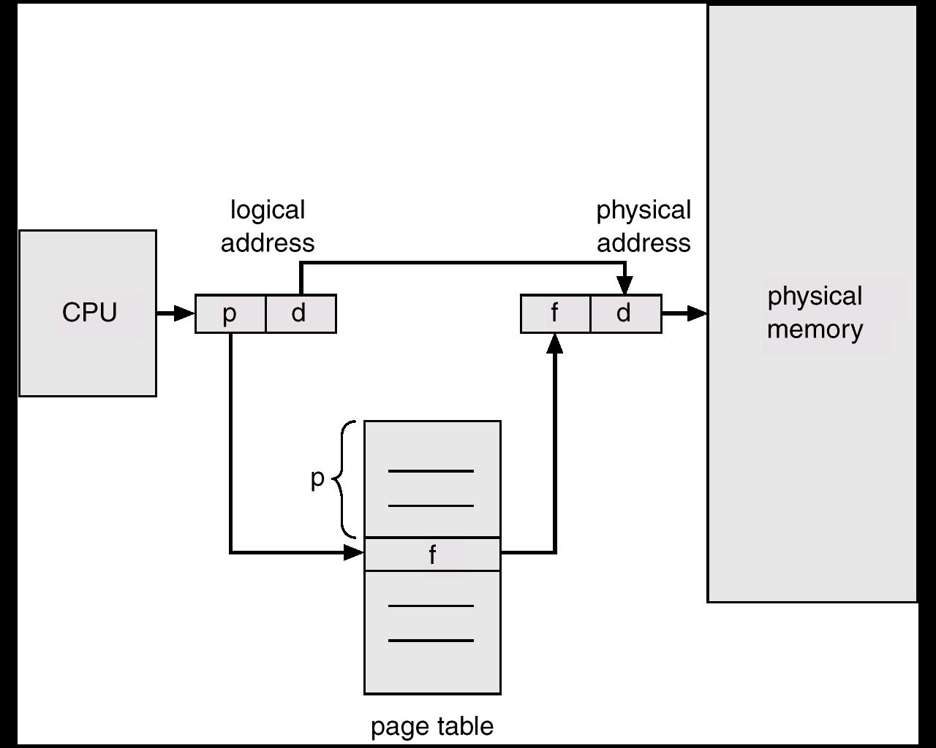
Address Translation Scheme (Cont.)
Page size: 2^{n}
Logical address
space: 2^{m}
Number of
pages: 2^{m-n}
n bits
p
d
m-n bits
CE2005/CZ2005 Operating Systems
Notes:
This figure suggests a hardware implementation. When a particular process is running, a register holds the starting address of the page table for that
process. The page number of a virtual address is used to index that table and look up the corresponding frame number. This is combined with the offset portion of the virtual address to produce the desired real address. Typically, the page number field is longer than the frame number field.

Slide 23
Address Translation Scheme (Cont.)
Page Size (and Frame Size): 4 bytes
page #
frame #
Size of
Physical
memory:
8x4 = 32 bytes
8 Frames
0
1
1
1
Logical address space:
4x4 = 16 bytes
4 Pages
1
1
0
1
1
CE2005/CZ2005 Operating Systems

Slide 24
Implementation of Page Table
Page table is kept in main memory.
Page-table base register (PTBR) points to the page table (for each process).
Page-table length register (PRLR) indicates size of the page table.
In this scheme every data/instruction access requires two memory accesses: one for the page table and one for the data/instruction.
  Effective memory access time = 2 μ (assuming that memory cycle time is μ time unit)
Memory access time can be reduced by the use of a special fast-lookup hardware cache called associative registers or translation look-aside buffers (TLBs)
CE2005/CZ2005 Operating Systems
Notes:
PAGE TABLE STRUCTURE The basic mechanism for reading a word from memory involves the translation of a virtual, or logical, address, consisting of page number and offset, into a physical address, consisting of frame number and offset, using a page table. Because the page table is of variable length, depending on the size of the process, we cannot expect to hold it in registers. Instead, it must be in main memory to be accessed.
With paging, the logical-to-physical address translation is still done with hardware support. Now the CPU must know how to access the page table of the current process -> page-table base register and page-table length register

Slide 25

Paging Using TLBs
CE2005/CZ2005 Operating Systems
Notes:
In principle, every virtual memory reference can cause two physical memory accesses: one to fetch the appropriate page table entry and one to fetch the desired data. Thus, a straightforward virtual memory scheme would have the effect of doubling the memory access time. To overcome this problem, most virtual memory schemes make use of a special high-speed cache for page table entries, usually called a translation lookaside buffer (TLB) .
Associate registers, parallel search
Typically 64 to 1024 entries

Slide 26
Effective Access Time
TLBs Lookup = ε time unit
Assume memory cycle time is μ time unit
Hit ratio – percentage of times that a page number is found in the associative registers.
Hit ratio = α
Effective Access Time (EAT)
EAT = (μ + ε) α + (2 μ + ε)(1 – α)
= (2- α) μ + ε
CE2005/CZ2005 Operating Systems

Slide 27
Two-Level Page-Table Scheme
A logical address (on 32-bit machine with 4K page size)
  2²⁰ entries in a page table
  If each entry consists of 4 bytes, each page table occupies 4 megabyte of memory!
A large page table is divided up to be easier to allocate in main memory, with a small increase in effective access time
CE2005/CZ2005 Operating Systems

Slide 28
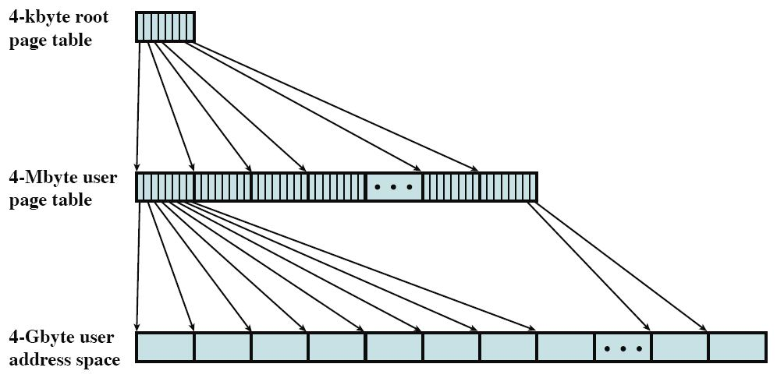
Two-Level Page-Table Scheme (Cont.)
Number of Entries: 2¹⁰
4-Kbye outer
(4 x 2¹⁰ Bytes)
Number of Entries
Per Page: 2¹⁰
(4 x 2²⁰ Bytes)
Entry Size: 4 Bytes
(2³² Bytes)
Page Size: 4 x 2¹⁰ Bytes
CE2005/CZ2005 Operating Systems
Notes:
This figure shows an example of a two-level scheme typical for use with a 32-bit address. If we assume byte-level addressing and 4-kbyte (2 12 ) pages, then the 4-Gbyte (2 32 ) virtual address space is composed of 2^20 pages. If each of these pages is mapped by a 4-byte page table entry, we can create a user page table composed of 2^20 entries requiring 4 Mbytes (2^22 ). This huge user page table, occupying 2^10 pages, can be kept in virtual memory and mapped by an outer page table with 2^10 entries occupying 4 Kbyte (2^12 ) of main memory.

Slide 29
Two-Level Page-Table Scheme (Cont.)
A logical address (on 32-bit machine with 4K page size) is divided into:
  a page number consisting of 20 bits.
  a page offset consisting of 12 bits.
Since the page table is paged, the page number is further divided into:
  a 10-bit p₁
  a 10-bit p₂
The outer page table contains
(4 x 2²⁰) / 4K = 2¹⁰ number of entries
Each page in the page table contains
(4 x 2¹⁰) / 4 = 2¹⁰ number of entries
CE2005/CZ2005 Operating Systems

Slide 30
Two-Level Page-Table Scheme (Cont.)
Thus, a logical address is as follows:
where p₁ is an index into the outer page (second level) table, and p₂ is the displacement within the page of the inner (first level) page table.
page number
page offset
p₁
p₂
d
10
10
12
CE2005/CZ2005 Operating Systems

Slide 31

Two-Level Page-Table Scheme (Cont.)
Address-translation scheme for a two-level 32-bit paging architecture
PTBR
physical address
F#2
F#2
d
F#1
F#2
physical
memory
CE2005/CZ2005 Operating Systems
Notes:
This figure shows the steps involved in address translation for this scheme. The outer page table always remains in main memory. The first 10 bits of a virtual address are used to index into the outer page table to find an entry for a page of the page table. If that page is not in main memory, a page fault
occurs. If that page is in main memory, then the next 10 bits of the virtual address index into the page table to find the entry for the page that is referenced by the virtual address.

Slide 32
Inverted Page Table
Usually each process has its own page table. Hence the system could have many page tables,
consuming substantial memory space
  The page table size is proportional to that of the logical address space.
Alternative: have a single table with one entry for each physical frame, as <process-id, page-no>. This is called an Inverted Page Table
Logical address: <process-id, page-no, offset>
Increases search time: table sorted by physical address but lookups occur on logical address
CE2005/CZ2005 Operating Systems
Notes:
@In our last lesson, we start with talking about address binding, how to bind the process space to the main memory. Then, we talk about logical vs. physical space. Then, we talk about contiguous allocation and non-contiguous allocation. For contiguous allocation, we need to understand fix partition and dynamic partition. For non-contiguous allocation, we have studied paging. you should be able to understand the basic scheme, the concept of translation lookahead buffer. then, you need to know how to do the calculations on two-level paging.
A drawback of the type of page tables that we have been discussing is that their size is proportional to that of the virtual address space.
An alternative approach to the use of one or multiple-level page tables is the use of an inverted page table structure.
Ordered by the frame order.

Slide 33

Inverted Page Table (Cont.)
To access memory, the pair <process-id, page-no> is presented to inverted page table to find a match.
If match is found, say at entry i, then physical addr <i, offset> is obtained.
i
CE2005/CZ2005 Operating Systems
Notes:
Overhead in locating an entry, since entries are arranged in the frame order. Rather than process id/page no.
Pid: process id, p: page number, and d for offset.

Slide 34
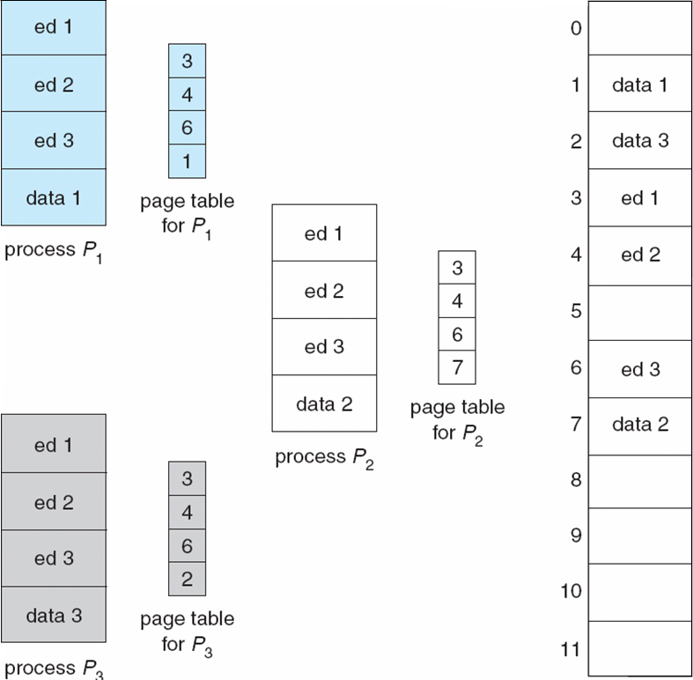
Shared Pages
Logical space
physical memory
CE2005/CZ2005 Operating Systems
Notes:
Processes may access the same data, such as in this figure, process P1, P2 and P3 have shared the code for an editor with three pages ed1, ed2, and ed3. they have different input data though, pages data1, data2, and data3. we need shared pages to reduce the memory usage.
Shared code
One copy of read-only (reentrant) code shared among processes (i.e., text editors, compilers, window systems).
Shared code must appear in same location in the logical address space of all processes
Private code and data
Each process keeps a separate copy of the code and data
The pages for the private code and data can appear anywhere in the logical address space

Slide 35

Segmentation
A memory-management scheme that break program up into its logical segments, and allocating space for these segments into memory separately.
Unlike pages, segments can be of variable size
A process has a collection of segments.
Like pages of a process, segments of a process may not be allocated contiguously
logical address space
CE2005/CZ2005 Operating Systems
Notes:
A program is a collection of segments. A segment is a logical unit such as:
main program,
function,
local variables, global variables,
stack,
symbol table, arrays

Slide 36
Segmentation (Cont.)
1
1
4
2
3
4
2
3
user space
physical memory space
logical address space
CE2005/CZ2005 Operating Systems
Notes:
This organization has a number of advantages to the paging scheme:
It simplifies the handling of growing data structures.
If the programmer doesn’t know ahead of time how large a particular data structure will become, it is necessary to guess unless dynamic segment sizes are allowed. With segmented virtual memory, the data structure can be assigned its own segment, and the operating system will expand or shrink the segment as needed.
If a segment that needs to be expanded is in main memory and there is insufficient room, the operating system may move the segment to a larger area of main memory, if available, or swap it out. The enlarged segment would be swapped back in at the next opportunity.
2. It allows programs to be altered and recompiled independently,
without requiring the entire set of programs to be relinked and reloaded.
Again, this is accomplished using multiple segments.
3. It lends itself to sharing among processes.
A programmer can place a utility program or a useful table of data in a segment that can be referenced by other processes.
4. It lends itself to protection.
Because a segment can be constructed to contain a well-defined set of programs or data, the programmer or system administrator can assign access privileges in a convenient fashion.

Slide 37
Address Translation
Each segment has a segment no. & offset, i.e., its logical address is:
<segment-no, offset>,
Segment table. Each table entry has:
  base – contains the starting physical address where the segments reside in memory.
  limit – specifies the length of the segment.
Segment-table base register (STBR) points to the segment table’s location in memory
Segment-table length register (STLR) indicates number of segments used by a program;
CE2005/CZ2005 Operating Systems

Slide 38
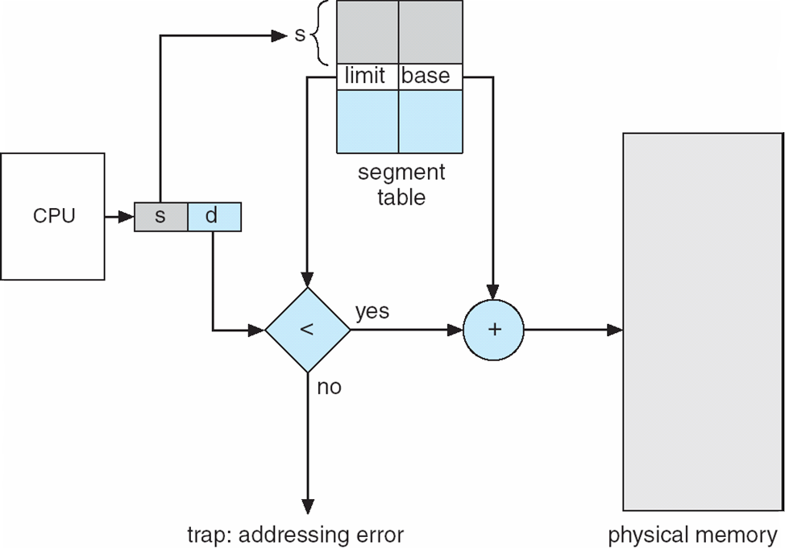
Address Translation (Cont.)
Lookup segment table
-> entry s
(2) Check if d<limit
(3) address=base+d
CE2005/CZ2005 Operating Systems

Slide 39
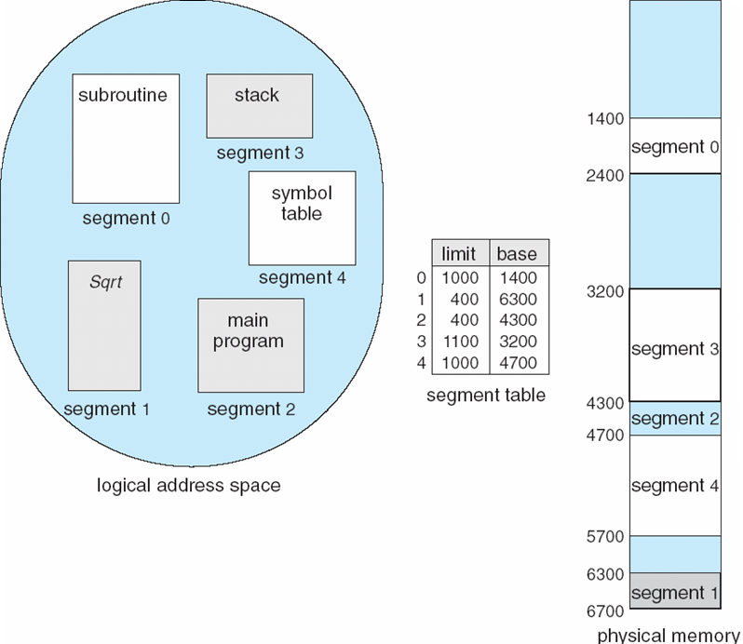
Address Translation (Cont.)
128
Q: translate <3, 128>
Ans: (1) lookup segment table → base=3200, limit=1100
(2) 128<1100, true.
(3) address=3200+128 =3328.
CE2005/CZ2005 Operating Systems

Slide 40
Fragmentation in Segmentation
Since segments vary in length, memory allocation is a dynamic storage-allocation problem. Usually use best-fit or first-fit.
Suffer from external fragmentation as process leaves the system, its occupied segments become holes in the memory.
As a process leaves the system, its occupied segments become holes of varying sizes
in the memory.
CE2005/CZ2005 Operating Systems
Notes:
Memory allocation of a segmentation is similar to dynamic partitioning. Various dynamic storage allocation strategies (e.g., first-fit, best-fit, and worst-fit) can be used. The difference, compared to dynamic partitioning, is that a process image may occupy more than one partition, and these partitions need not be contiguous. Segmentation eliminates internal fragmentation but, like dynamic partitioning, it suffers from external fragmentation. However, because a process is broken up into a number of smaller pieces (segments), the external fragmentation should be less.

Slide 41
Summary
Programs must be brought into memory for execution ⇒ Memory Allocation
  Contiguous Allocation
    fix partition vs. dynamic partition
  Non-contiguous Allocation
    paging vs. segmentation
  Fragmentation Problem
CE2005/CZ2005 Operating Systems

Slide 42
Summary (Cont.)
Process executes in its logical address space, but the actual code and data are stored in physical memory ⇒ Mapping of logical address to physical address
  Paging
    basic scheme
    using translation look-aside buffer
    double-level paging
    inverted page table
  Segmentation
    basic scheme
CE2005/CZ2005 Operating Systems

